Slide 1

Ruby on Rails

Slide 2
About today…
Ruby on Rails
AJAX in Rails

Slide 3


Slide 4

Intro to AJAX in Rails
AJAX (Asynchronous JavaScript and XML) allows you to update parts of a web page without reloading the entire page
In Rails, AJAX is commonly used for dynamic updates and improving user experience

Slide 5

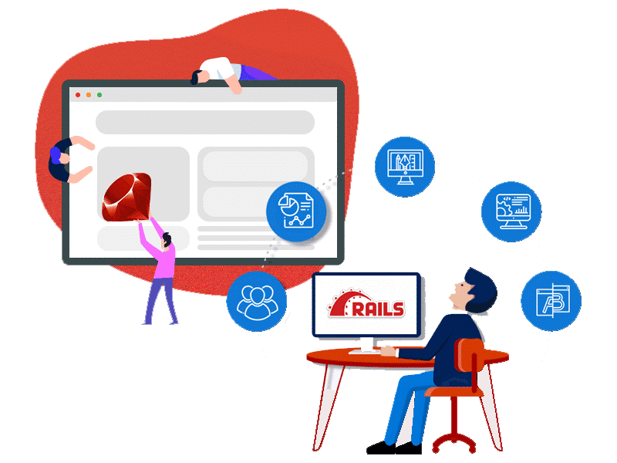
Create new Rails application

Slide 6
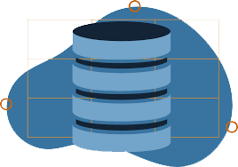
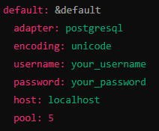

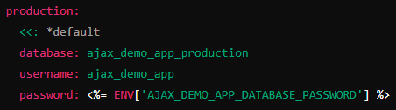


Configure the Database
Open the config/database.yml file and update the default configuration
Create the Database

Slide 7
Generate Model and Controller
Generate a Post Model
We'll create a simple Post model with a title and body
Run the Migrations
Apply the migrations to create the posts table in the database
Run the Migrations
Generate a Posts controller with the necessary actions

Slide 8
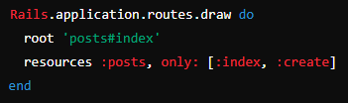
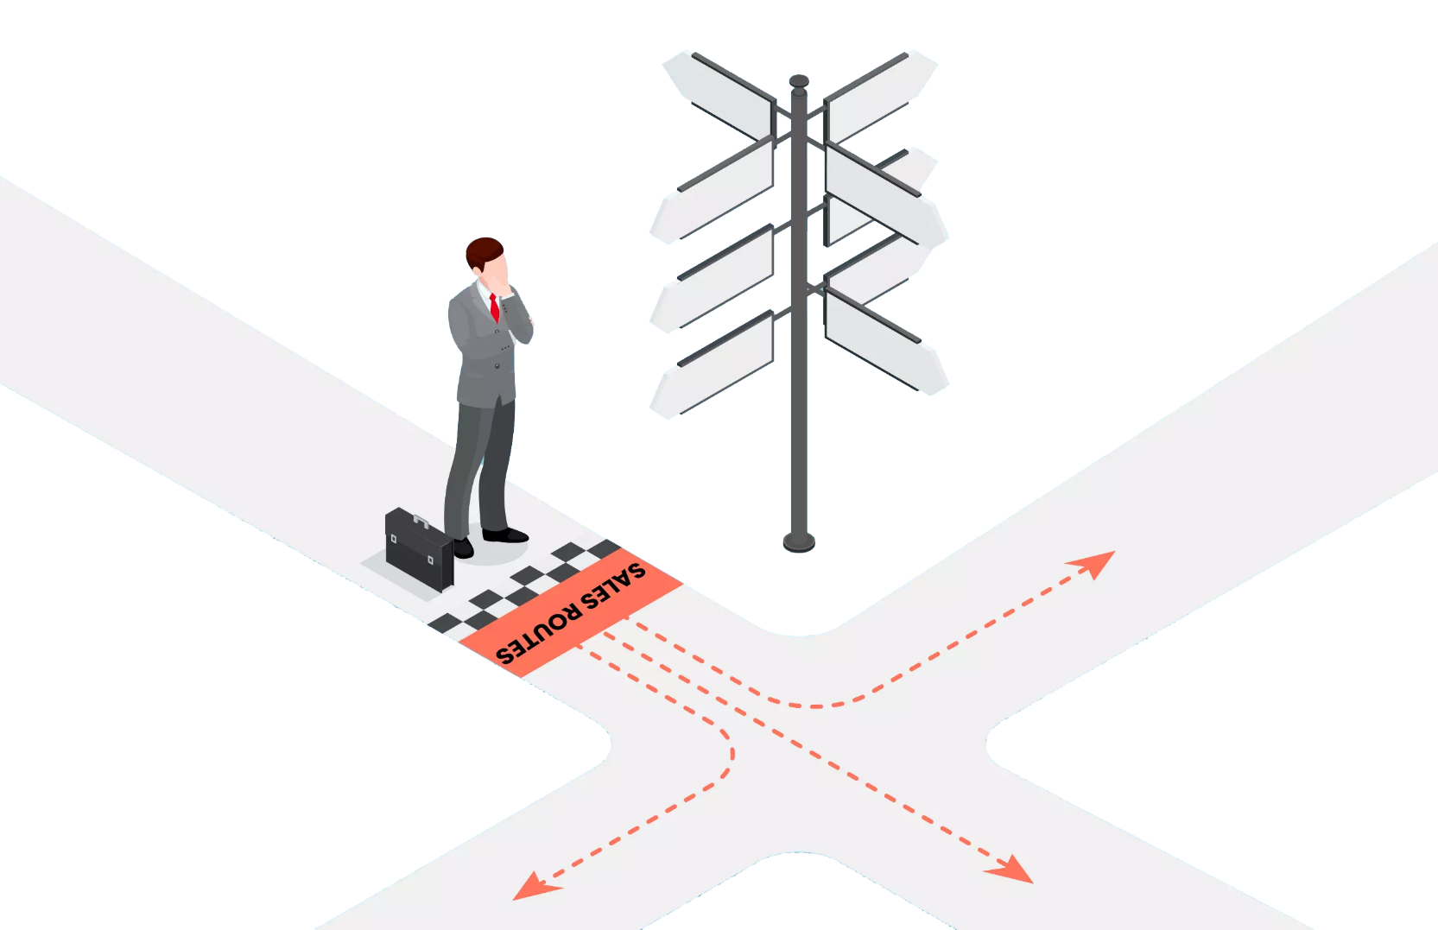
Setup routes
Open config/routes.rb and set up the routes

Slide 9

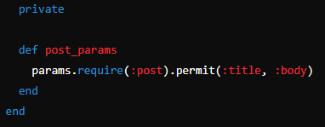
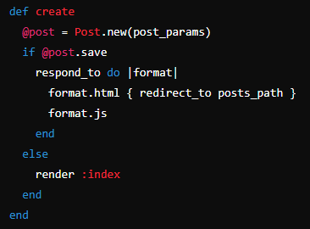

Modify Post Controller
Update the PostsController to handle AJAX requests

Slide 10
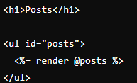
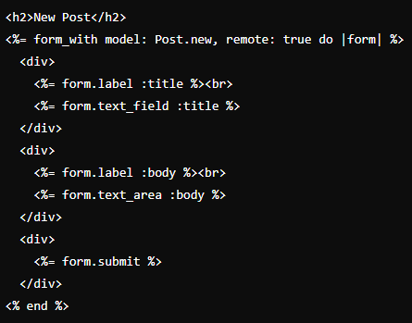

Create the Index View
Create the index.html.erb view for displaying posts and the form for creating new posts

Slide 11
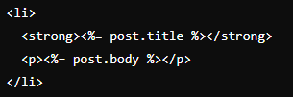

Create a Partial for Post
Create a partial _post.html.erb to render individual posts

Slide 12

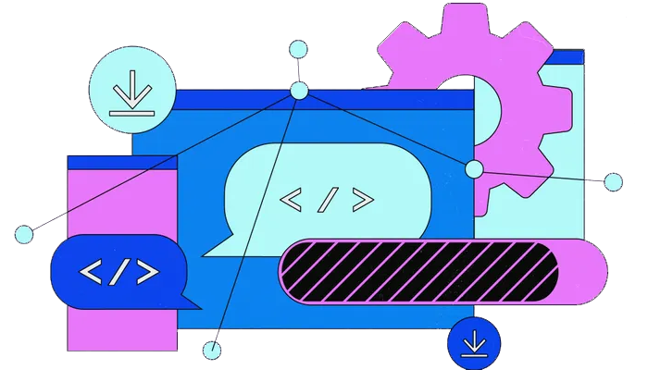
Implement AJAX Functionality
Create the JavaScript Response
Create the create.js.erb file to handle the AJAX response

Slide 13

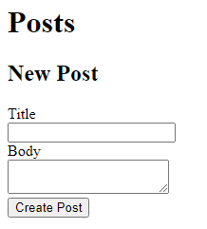
Run the Rails Server
Start the Rails server to see everything in action
Open Your Browser
Navigate to http://localhost:3000

Slide 14


Slide 15

How does Rails handle AJAX requests by default?
Using unobtrusive JavaScript (UJS) with the remote: true option in forms or links to send AJAX requests
What is the purpose of the respond_to block in a Rails controller action that handles AJAX requests?
It allows the controller to respond differently based on the format of the request, such as HTML or JavaScript (js)
Which file extension is used for AJAX response templates in Rails?
.js.erb files are used for AJAX response templates in Rails
How can you trigger an AJAX request in Rails when submitting a form?
By adding remote: true to the form_with helper in the view

Slide 16

Task 1
Implement write operation with Ajax in Ruby on Rails

